Slide 1
Periodic Noise Reduction by Frequency Domain Filtering

Slide 2
Introduction
Periodic noise
unwished and spurious signals that create repetitive pattern on images and decrease the visual quality
Due to electrical or electromagnetic interference
Eg., imager system is mounted on a vibrating holder
TV receiving signal is weak
appears as concentrated bursts of energy in the Fourier transform
Location → at frequencies of the periodic interference
Easily analysed and filtered effectively using frequency domain techniques
Eg., Use a selective filter

Slide 3
Examples of Selective Filters
Band Reject Filters
Ideal
Butterworth
Bandpass
Filters
Notch
Filters
Optimum Notch
Filters
Gaussian

Slide 4
Band Reject Fitlers
Removing periodic noise form an image involves removing a particular range of frequencies from that image
Band reject filters can be used for this purpose

Slide 5
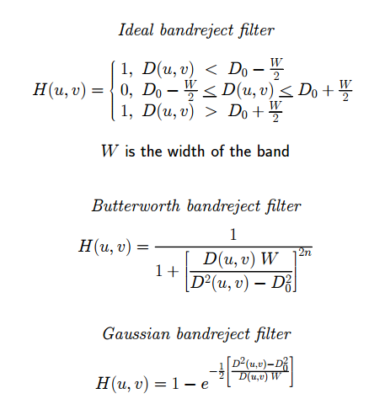

Slide 6
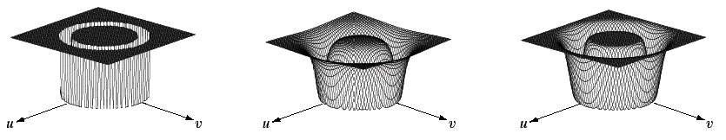

Band Reject Filters (cont…)
The ideal band reject filter is shown below, along with Butterworth and Gaussian versions of the filter
Images taken from Gonzalez & Woods, Digital Image Processing (2002)
Ideal Band Reject Filter
Butterworth Band Reject Filter (of order 1)
Gaussian Band Reject Filter

Slide 7
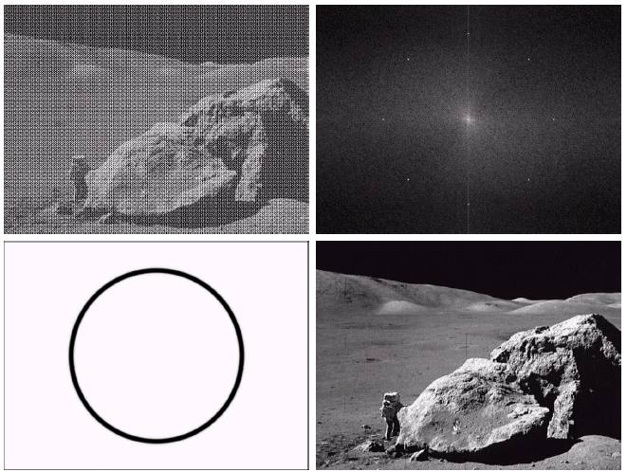
Band Reject Filter Example
Image corrupted by sinusoidal noise
Fourier spectrum of corrupted image
Images taken from Gonzalez & Woods, Digital Image Processing (2002)
Butterworth band reject filter
Filtered image

Slide 8
BR Filters
Attenuate a band of frequency about the origin of the 2-D Fourier transform
used in periodic noise reduction applications where the general location of the noise components is approximately known in the frequency domain
when the distances of the periodic noise components about the origin of the 2-D Fourier transform are different
a wide bandreject filter, or
several narrow band-reject filters
In both cases, the restored image may lose some important image information.

Slide 9
Band Pass Filters
Opposite operation of band reject filters
Straight performing of BP filters on images → removes too much image details
Isolate the effects caused by selected frequency bands
Most of the image details are lost;
The info. is that of the noise’ -> isolates the noise patterns
Easy analysis of the noise pattern independent of the image content.

Slide 10
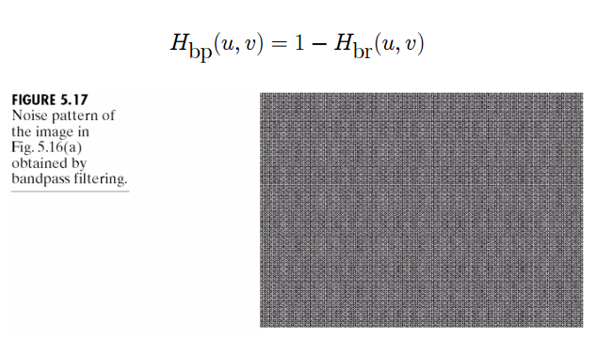
Band Pass Filters

Slide 11
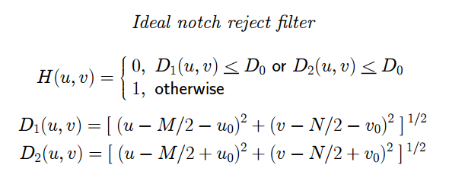
Notch Filters
Rejects/passes frequencies in predefined neighbourhoods about a center frequency
Effect is symmetric about the origin

Slide 12
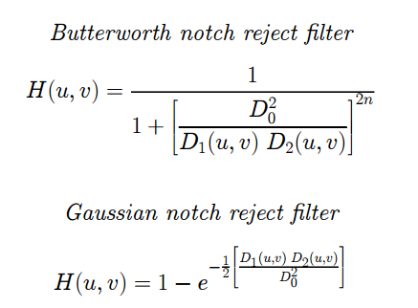
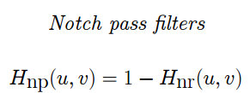

Slide 13
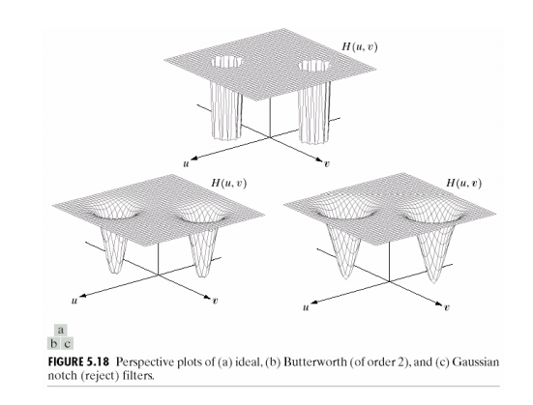

Slide 14
Notch-reject filter
Attenuates frequencies in predefined neighborhoods about a center frequency of the 2-D Fourier transform
Used to reduce the periodic noise effects where the main frequencies of the periodic noises are known
Automatic determining of both the periodic noise main frequencies and the corresponding band-width are challenge problems in this filter.

Slide 15
Notch Filters
Several interference components are present
Other methods are not useful
They may remove too much information
Interference components → multiple frequency bursts

Slide 16
Steps
Principal contribution of the inference repetitive pattern is extracted from the noisy image
Output image is restored by subtracting a variable weighted portion of the repetitive pattern from the contaminated image
The extractions of the repetitive pattern is implemented in frequency-domain by applying a proper notch-pass filter on every periodic noise frequency
Then by applying inverse 2-D Fourier transform to restore the repetitive pattern in spatial-domain

Slide 17
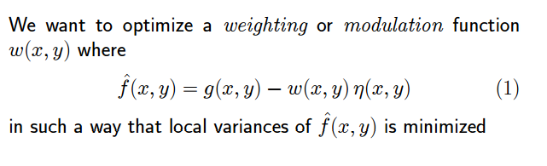

Slide 18
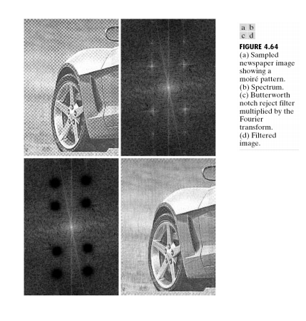

Slide 19
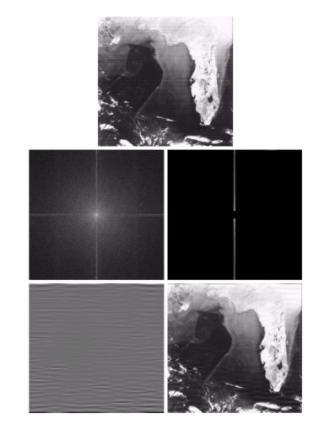

Slide 20
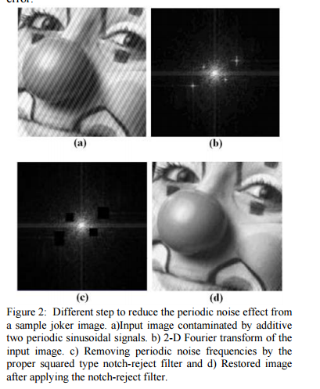

Slide 21
Inverse Filter
From degradation model:
after we obtain H(u,v), we can estimate F(u,v) by the inverse filter:
Noise is enhanced
when H(u,v) is small.
To avoid the side effect of enhancing
noise, we can apply this formulation
to freq. component (u,v) with in a
radius D₀ from the center of H(u,v).
In practical, the inverse filter is not
Popularly used.
(Images from Rafael C. Gonzalez and Richard E.
Wood, Digital Image Processing, 2nd Edition.

Slide 22
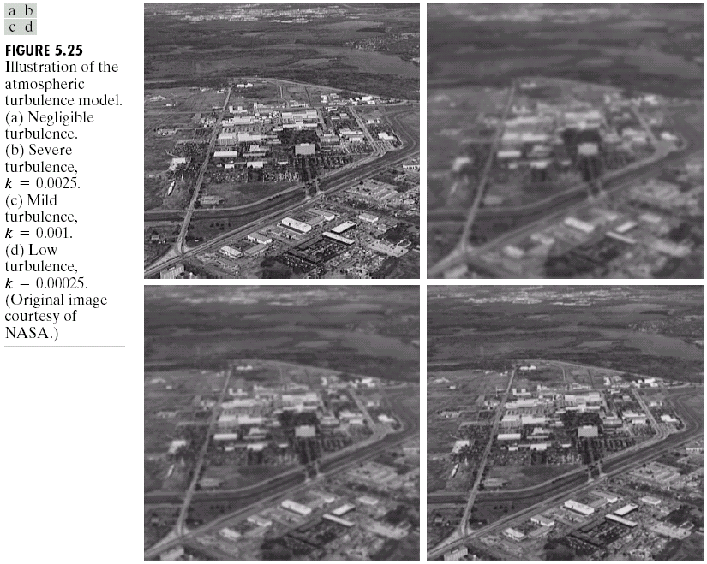
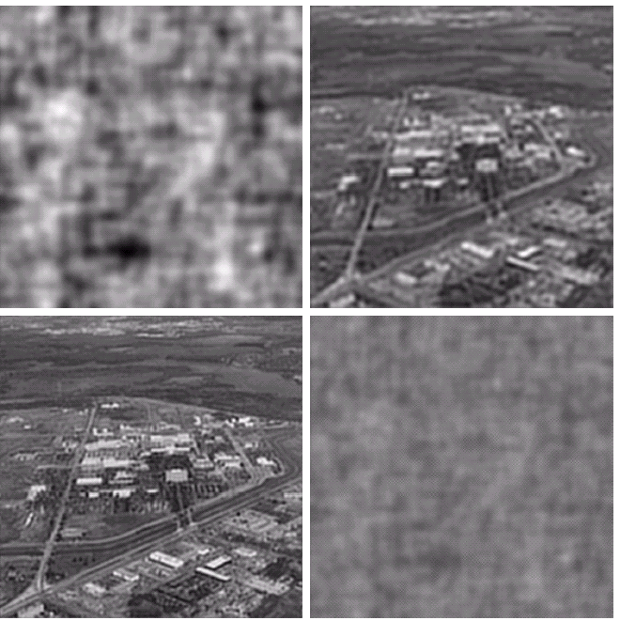
Inverse Filter: Example
Result of applying
the full filter
Result of applying
the filter with D₀=40
Original image
Blurred image
Due to Turbulence
Result of applying
the filter with D₀=70
Result of applying
the filter with D₀=85

Slide 23
Wiener Filter: Minimum Mean Square Error Filter
Objective: optimize mean square error:
Wiener Filter Formula:
where
H(u,v) = Degradation function
S_{η}(u,v) = Power spectrum of noise
S_{f}(u,v) = Power spectrum of the undegraded image
(Images from Rafael C. Gonzalez and Richard E.
Wood, Digital Image Processing, 2nd Edition.

Slide 24
Approximation of Wiener Filter
Wiener Filter Formula:
Difficult to estimate
Approximated Formula:
Practically, K is chosen manually to obtained the best visual result!

Slide 25
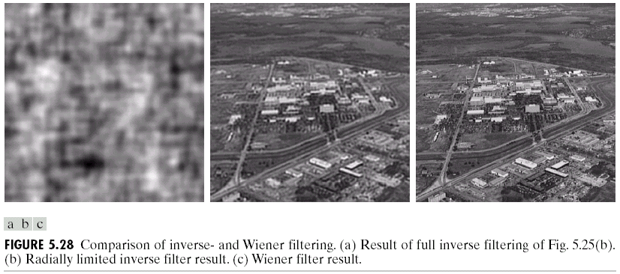
Wiener Filter: Example
Result of the
full inverse filter
Result of the inverse
filter with D₀=70
Original image
Blurred image
Due to Turbulence
Result of the
full Wiener filter

Slide 26
Wiener Filter: Example (cont.)
Result of the inverse
filter with D₀=70
Original image
Blurred image
Due to Turbulence
Result of the
Wiener filter

